Slide 1
CAPSTONE PROJECT SOLUTION DESIGN
Title: Blockchain based ticket management
Team members:
Rajith, Mayank, Priyanka, Debjit

Slide 2
SUMMARY
Date | Author | Comments
January 6, 2023 | Debjit Roy, Priyanka Dhiman | Initial version
January 8,2023 | Priyanka | Updated after internal review. Participants: Mayank, Rajith

Slide 3
CONTENT
Objective
Scope
Requirements
High Level solution design
Low level solution design
Future scope

Slide 4
OBJECTIVE
To help Eagle Airlines develop a unique blockchain based ticket management system to entice users with transparency, automated refunds and delay penalties.
To develop a base contract code using Solidity which will be deployed every time a ticket is bought by a customer from Eagle Airlines.

Slide 5
SCOPE
The airlines will deploy the contract with customer address and simulated dummy flight details. The customer will then call a specific function to transfer the ticket money to the contract and receive a confirmation id and flight details in response.
The features implemented in the smart contract are:
The customer should be able to trigger a cancellation anytime till 2 hours before the flight start time.
Any cancellation triggered by the airline before or after departure time should result in a complete amount refund to the customer.
The airline should update the status of the flight within 24 hours of the flight start time.
24 hours after the flight departure time, the customer can trigger a claim function to demand a refund.
Call based simulation of various features like normal flights, cancellation by the airline, cancellation by the customer, and delayed flights.
Add support for multiple cancellation penalties in favour of the airline, and delay penalties in favour of the customer, based on various time ranges in the contract.

Slide 6
REQUIREMENTS
FUNCTIONAL REQUIREMENTS:
Private ethereum blockchain using Geth
Nodes running on AWS EC2 machines with different ports
Clique (Proof of Authority)
Remix IDE connected to private blockchain
Base contract in Solidity language
Metamask chrome extension

Slide 7
ASSUMPTIONS
The following assumptions are made:
Nodes must be running on AWS EC2 instances on different ports.
Remix must be connected to private blockchain for successful transaction.
Airlines must be aware of the customer reservation Id. There must be database that is storing the customer reservation id for a flight.
Flight details’ inputs must be valid.
Customer address cannot be empty.

Slide 8
High Level Solution Design
TICKET
ticketData : TicketData(customer, airline, datetime, seatnum, etc) parent: TicketServer confirm(address, uint): public cancel(address): public delay(address, uint): public ontime(address): public claim(address): public getTicketDetails(): public getTicket(): public customer_cancel(): private refund_get(): private airline_cancel(address): private payment_get(): private
TICKETSERVER
bookedSeatList : mapping(bytes32->uint[]) ticketList: mapping(bytest32->Ticket) confirm(string, uint, uint8): public reserve(address, string, uint): public cancel(bytes32): public delay(bytes32, uint): public ontime(bytes32): public claim(bytes32): public transfer(address, uint): public getTicketDetails(bytes32): public getTicket(bytes32): public getNextseatNum(string, uint): private bookSeatNum(string, uint, uint8): private cancelSeatNum(string, uint, uint8): private
1
N

Slide 9
LOW LEVEL SOLUTION DESIGN

Slide 10
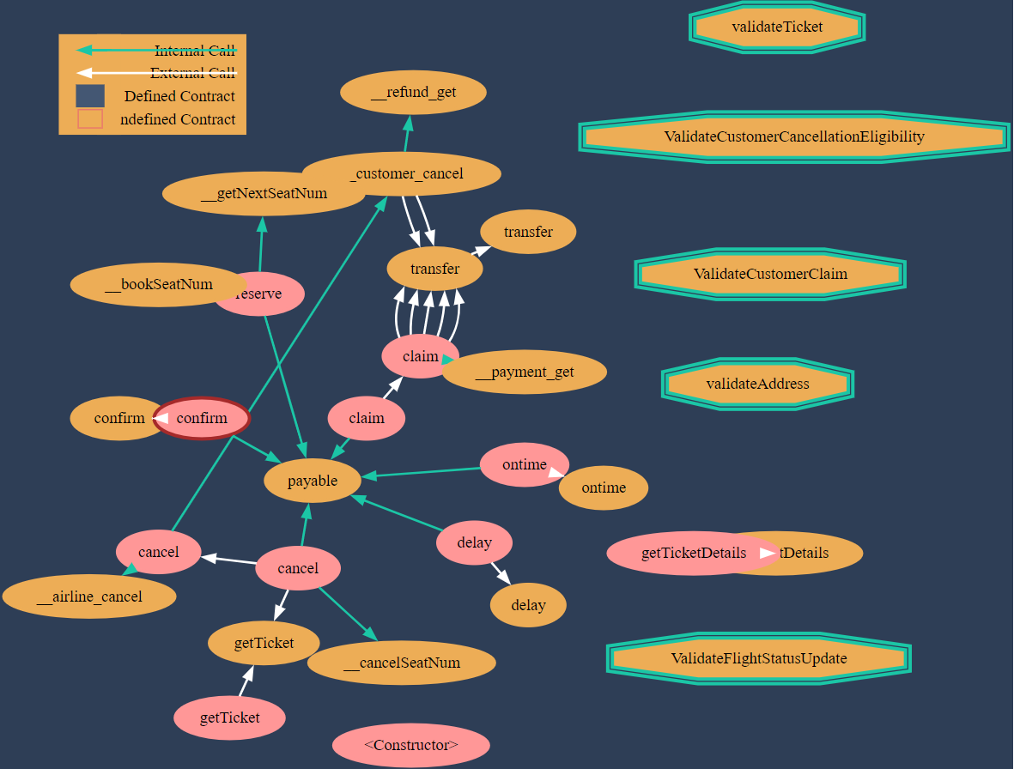

Slide 11
FUTURE SCOPE
The following features are taken as the future scope:
Instead of simulating the flight data and flight behaviour, we can use an Oracle to get actual flight information and act accordingly. This would require:
Defining smart contract with actual upcoming flight information and using the Oracle to update status.
Hyperledger Besu is an Ethereum based modified EVM with support for private transactions. We would enhance our solution by using Besu nodes and mark all transactions as private, only visible to the airline account and the customer account.

